Slide 1

Campus Key Hackathon: On Campus
Tommy Braccia, Sophia Chaltas, Noah McCashland, Adron Nguyen, Gianni Young
Notes:
Tommy

Slide 2
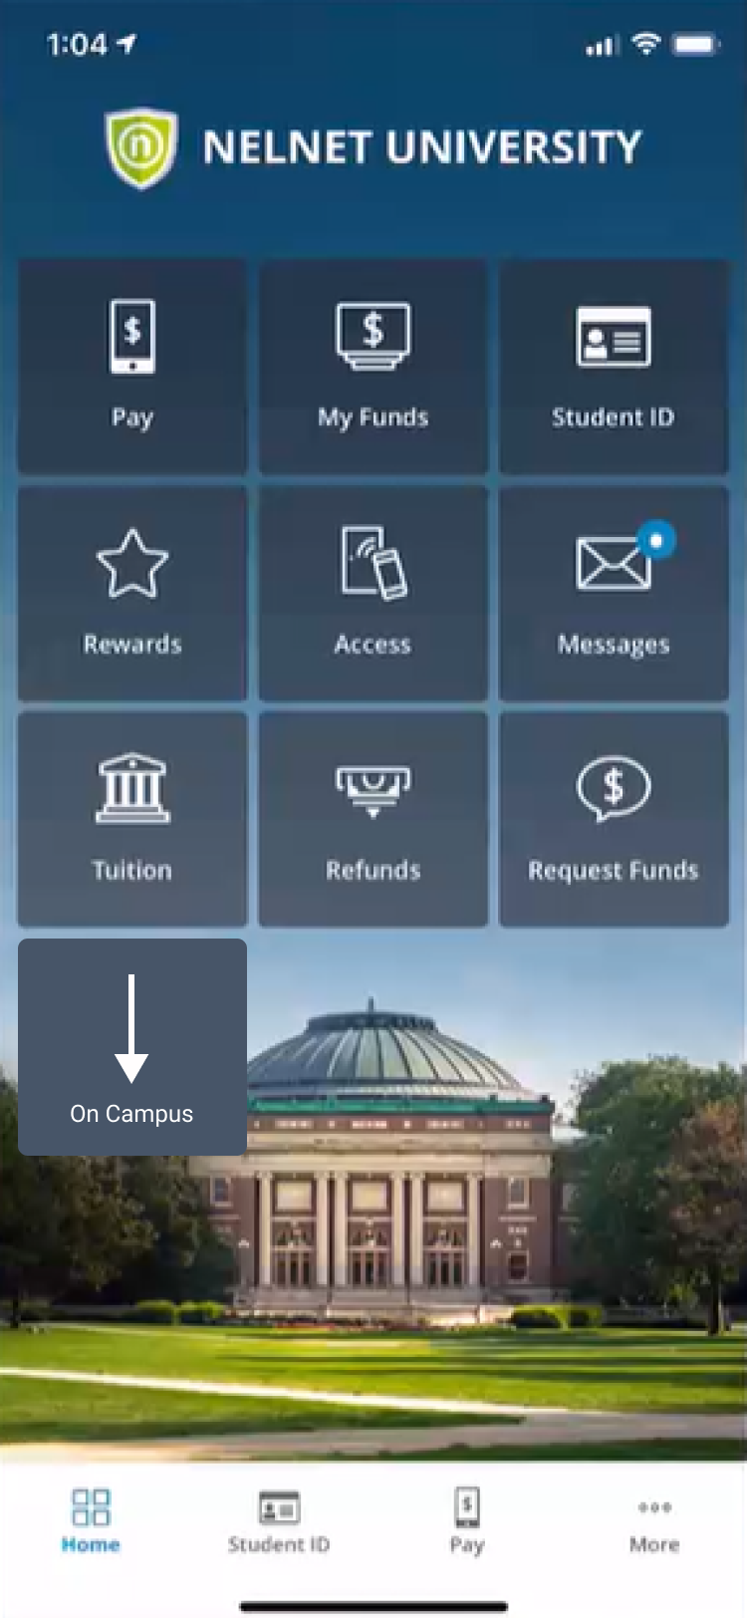

What is On Campus?
On Campus is a suite of tools that assists students while they are on campus.
It is a centralized place for students to see the current status of their campus facilities and get assistance when needed
Our currently proposed features include Security and Capacity
Notes:
Tommy

Slide 3
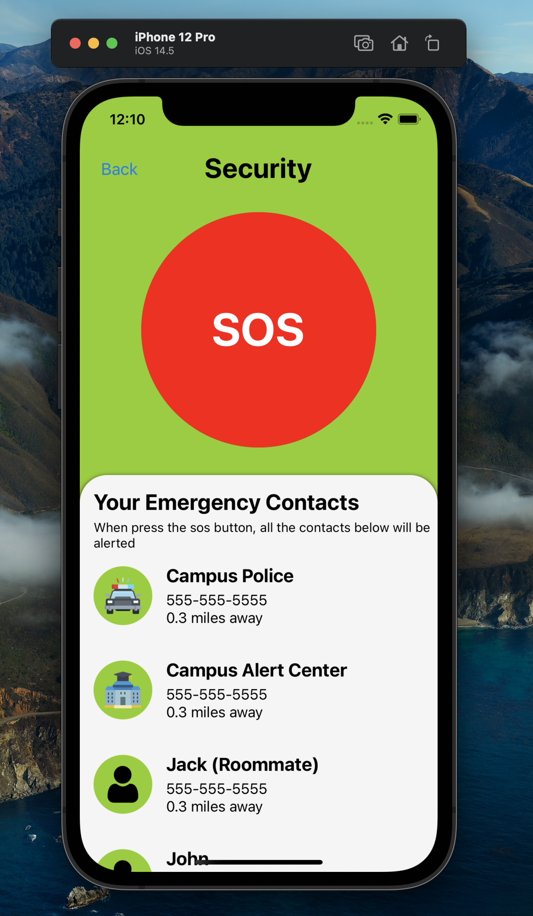
Security Screen
Large SOS button for students to use in case of an emergency
Students can add emergency contacts to be notified when the SOS button is pressed
Campus police will be notified when the SOS button is pressed
Students can see their proximity to their contacts and police
Notes:
Noah

Slide 4
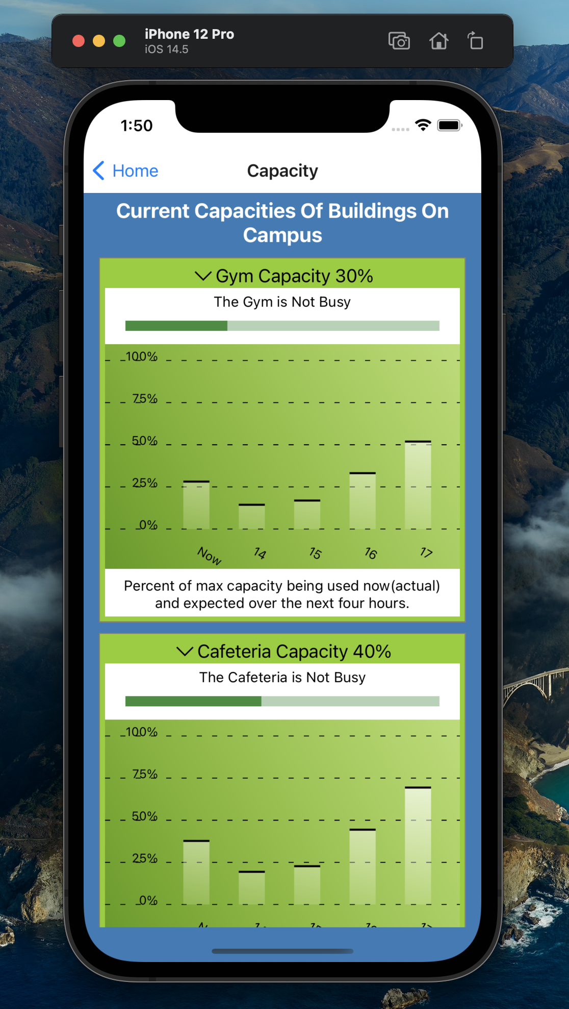
Capacity Screen
Shows the current capacity of multiple different locations around campus
Gyms
Dining Halls
Parking lots/garages
Capacity bar inspired by a fitness application capacity tracker
Bar graph shows the current capacity and expected capacity over the next four hours
Notes:
Sophia

Slide 5
DEMO
Notes:
Adron

Slide 6
Future Direction
Build a backend with database
Optimize UI/UX on both Android and iOS
Add capacity for laundry machines in dorm buildings, entertainment centers, etc.
Add a timer before activating SOS mode in case of accidental touches
Pressing the SOS button will turn on the flashlight or call
View the building hours for libraries, dining halls, gyms, etc.
Notes:
Gianni

